Slide 1
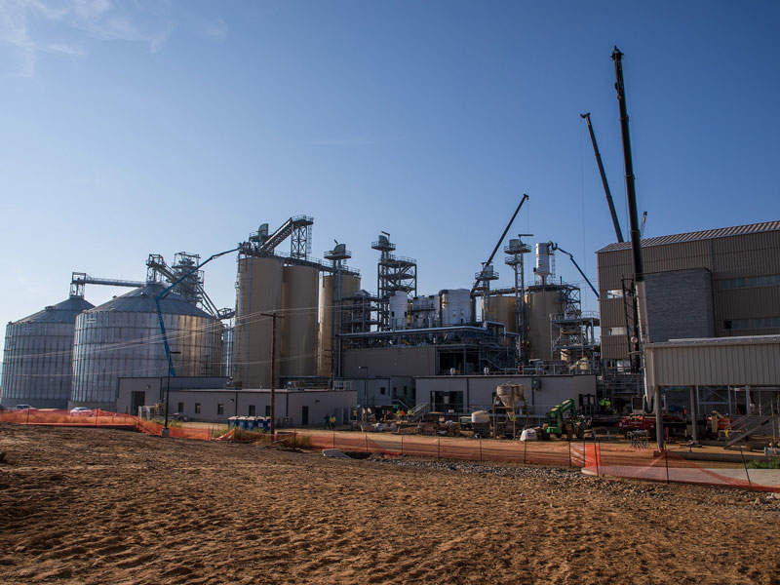
MY SUMMER AT PERDUE AGRIBUSINESS
Mia Hagood

Slide 2
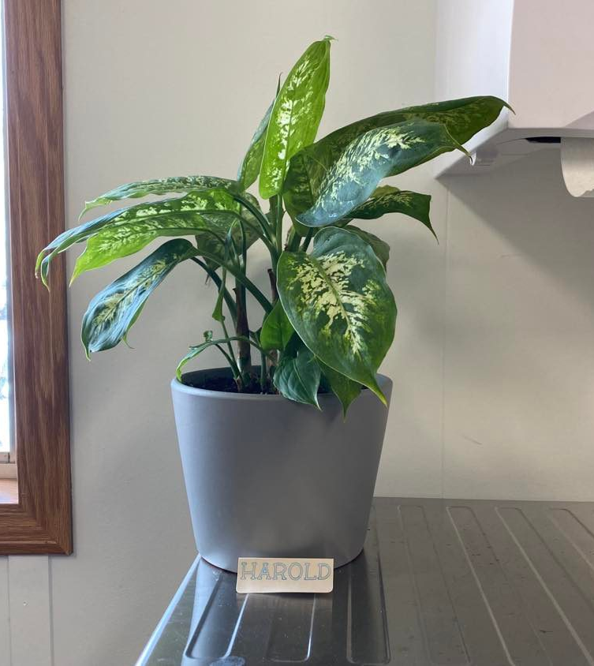
AGENDA
Environmental Scorecard Project
Introduction
Solution
Impact
Additional projects
Crystal Reports cleanup
oneWeigh archive
Shoutouts
Questions

Slide 3
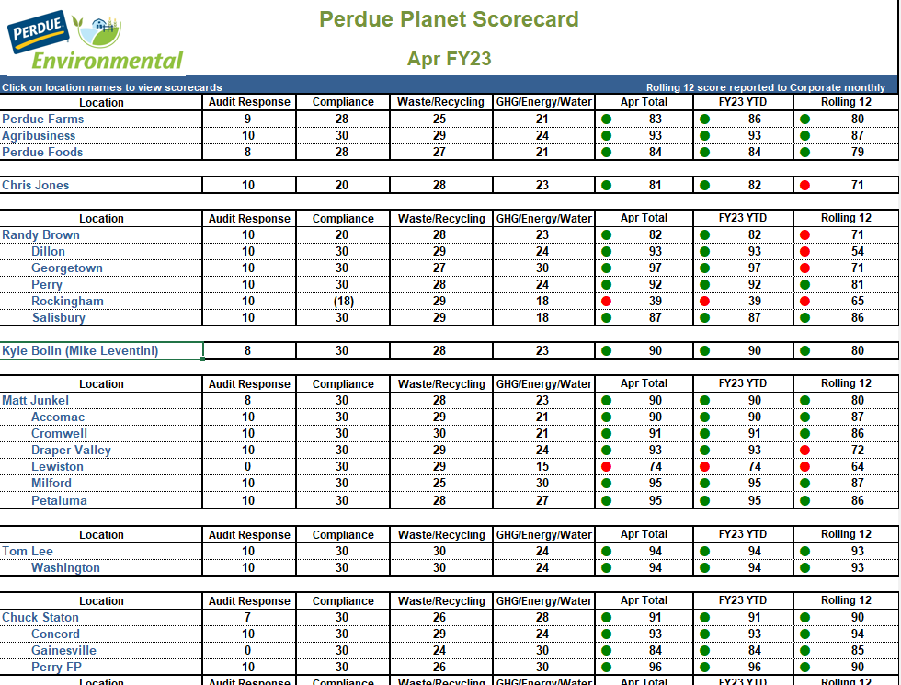
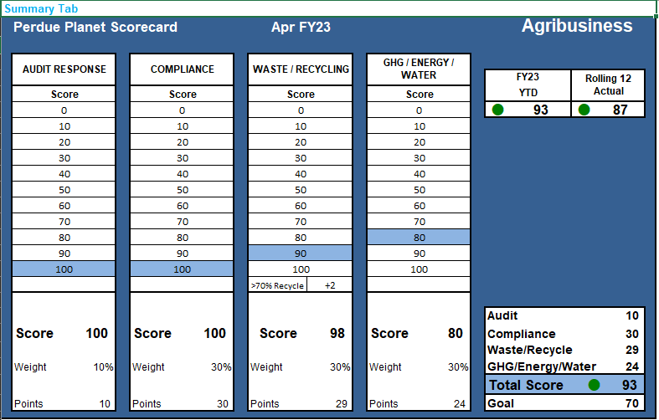
INTRODUCTION

Slide 4
INTRODUCTION
Data is sent in inconsistent formats
Confusing web of Frankensheets
Lots of time spent compiling the information

Slide 5
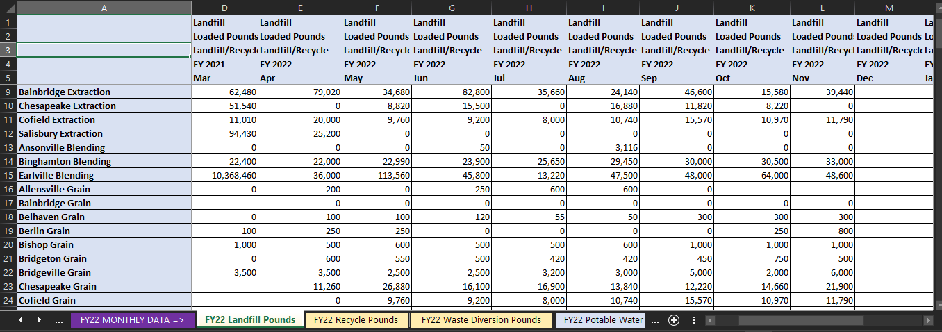
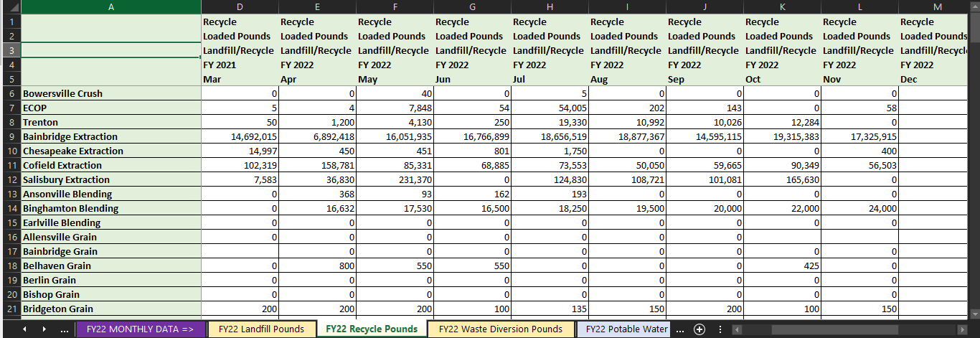
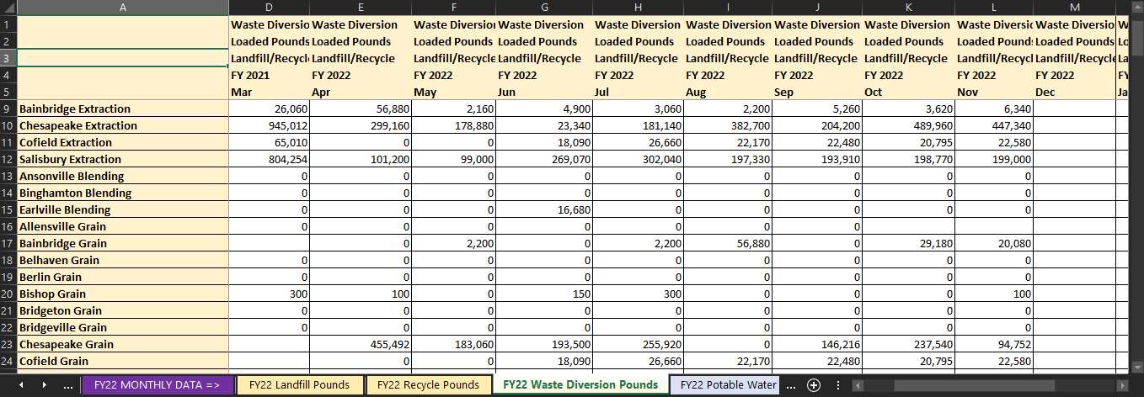
INTRODUCTION
Data is sent in inconsistent formats
Confusing web of Frankensheets
Lots of time spent compiling the information

Slide 6


SOLUTION

Slide 7

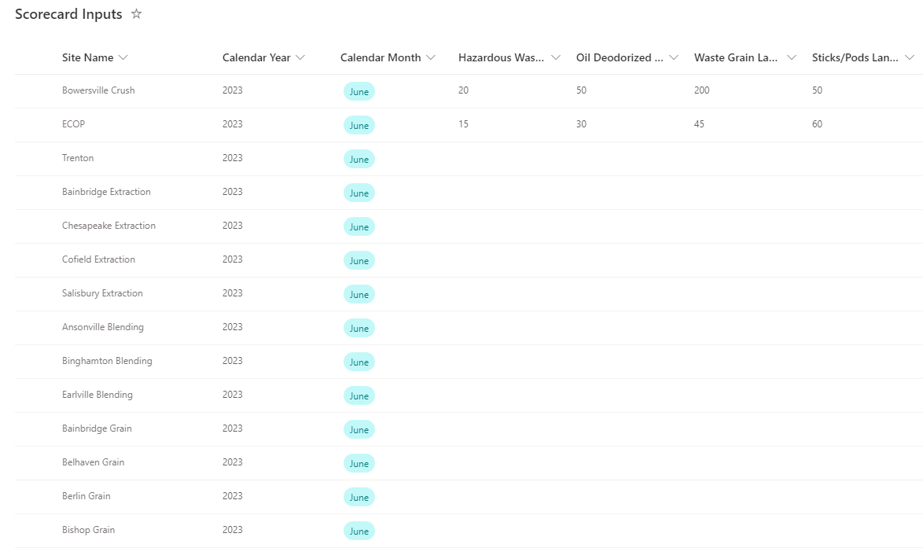
SharePoint List
Form Rules
???
Nintex Form

Slide 8

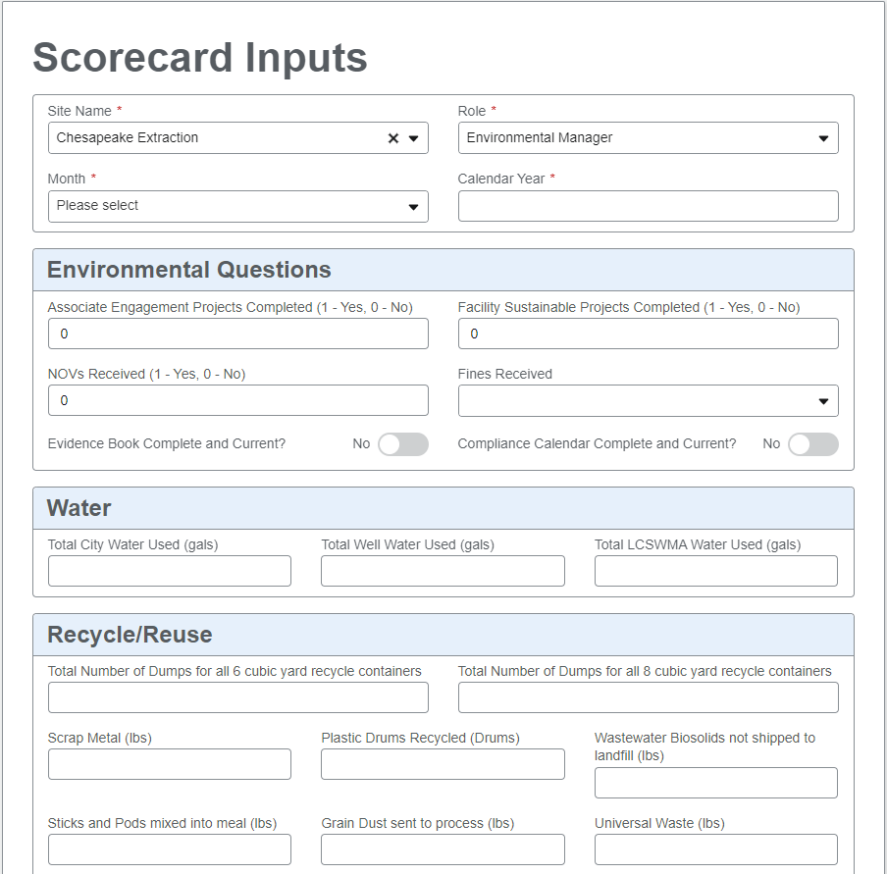
SharePoint List
Form Rules
???
Nintex Form

Slide 9

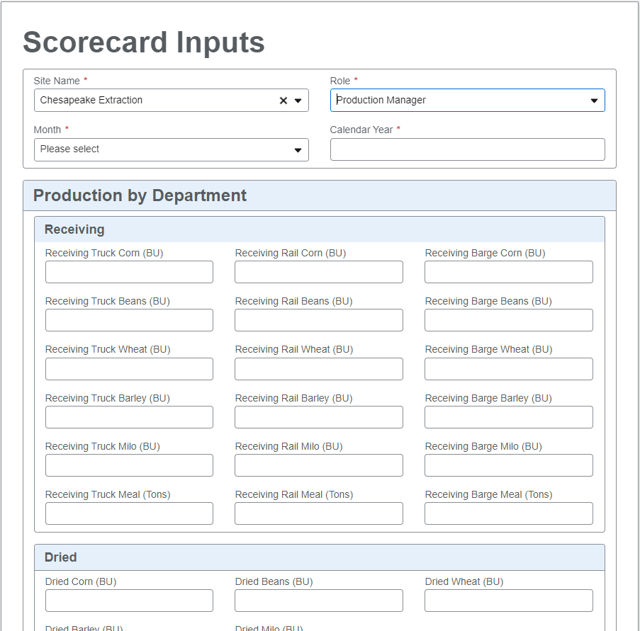
SharePoint List
Form Rules
???
Nintex Form

Slide 10

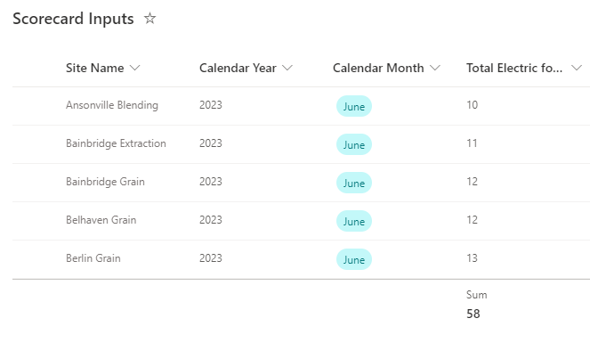
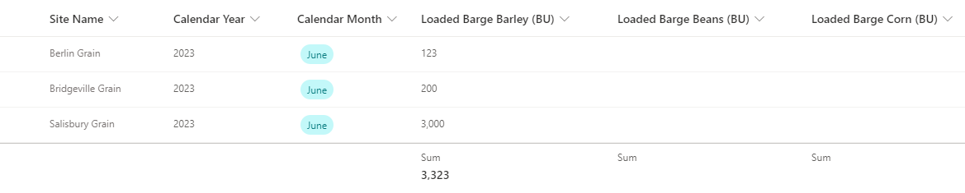
SharePoint List
Form Rules
???
Nintex Form

Slide 11

IMPACT
Saves time
Consistency
Automation

Slide 12

CRYSTAL REPORTS CLEANUP
What are Crystal Reports?
Automating report validation in different environments
Correcting errors

Slide 13
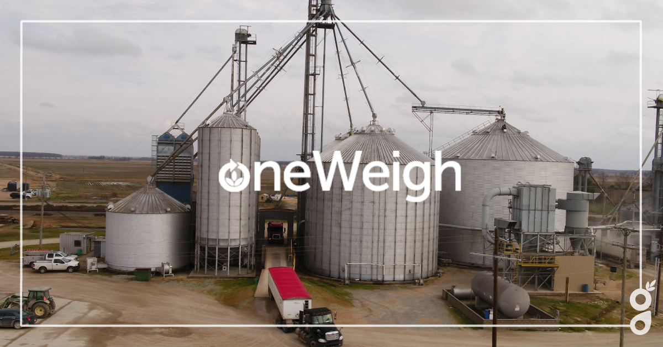
ONEWEIGH TICKET ARCHIVE
What is Oneweigh?
Designing the archive structure
Implementation

Slide 14

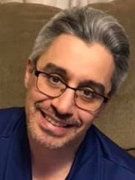
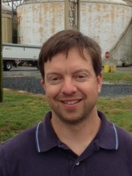
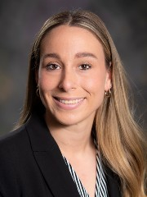
THANK YOU!
Wendy Leach
Senior Systems Analyst
Vinnie Perniciaro
Technical Lead
Caroline Phillips
University Relations/Campus Recruiter
Sean Howard
Director of Business App Services

Slide 15

QUESTIONS?

